Slide 1
Chi-Squared Analysis on Dessert Preferences
Russell Whitworth and Dean Marek

Slide 2
Data source
https://www.kaggle.com/vijayashreer/food-preferences
Our data comes from a sociology survey conducted on 288 individuals of a variety of ages and nationalities, primarily hailing from India.
The dataset discusses food and beverage preferences of each individual.

Slide 3
Data Breakdown
Our question in this dataset, does age hold a significant influence on dessert eating habits?
First, brackets of 20 years can be used to set bins of ages that would in this case represent significant gaps of age. This bin of course can be changed to be smaller or larger depending on a set preference.
These age brackets can then be used in table alongside responses to dessert preferences to get a count for each age brackets response to dessert being yes, maybe, or no.
From this we can determine using Chi - Squared analysis to determine if they have some dependency.

Slide 4
Hypothesis
H₀ = Age and Dessert Preference have no correlation and are independent variables.
H_{A} = Age and Dessert Preference have some correlation and are dependent variables.

Slide 5
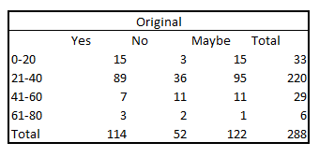
Methods of Data Organization
=COUNTIFS(A:A,">40",A:A,"<61",B:B,G3)

Slide 6
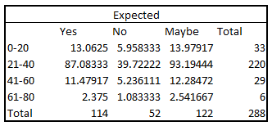

Expected Values Table

Slide 7
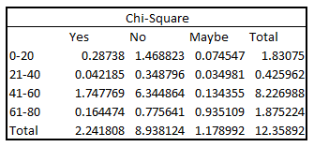

Chi-Square Table

Slide 8
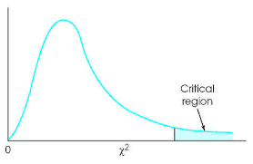
Calculations Using Obs.
Using 𝝌²_{obs} = 12.359 & d.f. = 6:
𝝌²_{6, 0.05} = 12.592
12.359 < 12.592; Do not reject Hₒ
𝝌²_{6, 0.10} = 10.645
12.359 > 10.645; Reject Hₒ

Slide 9
P-value
The p-value for 𝝌²₆ = 12.359 is 0.054423, meaning:
The result p = 0.054423 is not significant @ the p < 0.05 level, but is significant @ the p < 0.10 level.

Slide 10
Conclusions
Given a P-value of 12.36 with a degrees of freedom of 6, we find a P-Statistic of .05433, hence it is contained inside the rejection boundary of the 95% confidence interval, and outside rejection boundary of the 90% confidence interval.
Using 𝝌²_{obs} = 12.359:
Do not reject H₀ @ α = 0.05
Reject H₀ @ α = 0.10

Slide 11


